Slide 1
Tata AIA Analytics Offerings & Roadmap
Consumer Analytics Group,
Big Data Initiative

Slide 2
Agenda
Tata Customer Analytics Company Overview
  Mission and Value proposition
    3 points of Inflection and Service Offerings
Analytical Capabilities roadmap for Tata AIA Life
  Analytics Quick Wins (0-6 months)
  Proposed Roadmap
Next Steps, Team Collaboration and Support Needed

Slide 3
Executive Summary
Overview
Deck outlines the business priorities and a phased approach towards building and leveraging analytic capabilities for improving business outcomes for Tata AIA Life
Key areas of focus
Quick Wins (0-6 months)
Cross–Sell/Up-sell Strategies to increase product penetration/customer:
  Accelerate top line growth by leveraging internal, Tata eco-system, and external data to increase insurance product penetration across existing customers
Customer Retention:
  Retention of profitable customers and Policy renewal
Near-Long term (6 months+)
Leads Generation & Sales Optimization:
  Harness data to build forecasting, monitoring, and lead generation to accelerate sales conversion across all direct and indirect channels.
Financial Cluster analytics and Group wide Tata consumer data ecosystem
    Build One Tata consumer data eco-system and cross leverage data to build holistic insights, personalized offers, and superior customer experience

Slide 4
Tata Customer Analytics
Company Overview

Slide 5
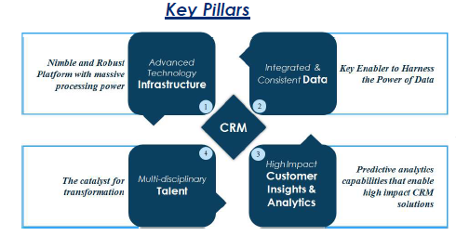
Tata Customer Analytics Division - Overview
Established as a strategic priority of the Tata Group to enhance customer Value, provide data driven decisions and promote customer centricity; CAD is committed to build a world class analytics organization
Unique Value Proposition
Cross Organization
Cross Cluster
Intelligence Access
Optimization
of Productivity
Analytic
Horsepower
Value Proposition
Evolution of Analytics
Decision Support
Decision Making
Decision Support
Decision Making
Reduced
Analytics Cap-Ex
Domain
Knowledge
Raw & Cleansed Data, MIS
Business Intelligence & Analysis
Predictive Modeling
Advanced Quantitative Science

Slide 6
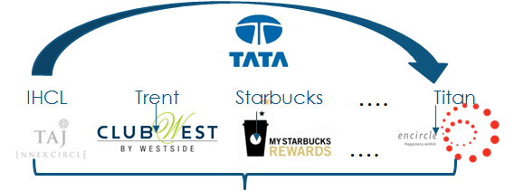



Strategy: 3 Points of Inflection
Single Tenant
Multi Tenant
One Tata
Gradual transition from single tenant to multi tenant segment level to multi tenant customer level
Group
Tata Group-wide Loyalty Alliance Program
Big data repository housing all Tata companies
Customer attributes across Group (360° view)
Tata Loyalty Alliance Program
Cluster
Defined customer segments across various clusters
Segment level information across LOB
No customer linkages
Full view of segment, limited view of customer
Company
Enhanced Customer centricity and Data driven organizations
No Data Sharing
Company level analytics solutions
Limited view of customer

Slide 7
Tata AIA Business Priorities

Slide 8










Analytics Opportunity Quadrants for Insurance organizations
Current focus is to increase insurance penetration, lead generation, and sales force optimization
Customer Management
Claim
Management
Risk Management
Channel, Sales & Distribution Management
Increase Cross-Sell/Up-sell
Social media analysis
Life-stage based targeting
Retention
Policy lapse & renewals
Service to Sales
Algorithm based Event triggers
Sales -force management
Sales forecasting at city/region level
Lead Generation and optimization
Increase penetration of digital as a channel
Call centre management
Planning and budgeting
Compliance management
Reinsurance policy management
Underwriting policy management
Actuarial analysis
Claims registration
Fraud detection
Claims estimation analysis
Medical Management
Identified Priority areas
Immediate/Near term Focus
Mid-Long term focus

Slide 9
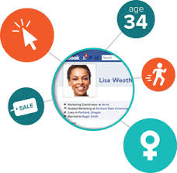






Tata AIA Business Priorities
The current business imperatives are to manage customer, sales and distribution, channel and claims efficiently
A
Understand the Customer
Increase Insurance
product penetration
Channel Management &
Digital analytics
B
C
D
Sales & Distribution Effectiveness
Develop a single and integrated view of the customer with internal and external data
  Classify customer value, potential and risk profile
Cross-sell/Upsell strategies
Service to Sales
Life-stage based offerings
  Policy Lapse & Renewals
  Customer Retention
Sales Agents performance Analysis
  Sales demand forecasting
  and optimization
  Alliance and Partner management
Lead prioritization & optimization across channels
  Focus on Digital as a channel
Immediate focus areas

Slide 10
Analytics Roadmap for Y1 & Y2
Prospect Database (Tata ecosystem and External)
Phased out key programs based on sources and availability of Data
1
2
3
Quick Wins
Foundation
Maturation
0 – 6 months
4 – 12 months
12 months +
Prospect/
Customer
Management
Product propensity, Cross-sell/Upsell strategies, Retention & Renewal
Digital acquisition/sales
Social Media Analytics
Sales, Channel & Distribution Management
Sales force Management (including DSAs) and Optimization
MIS/Advance Visualization
Marketing spend ROI efficiency, Campaign management
Claim and Customer Experience Management
Vendor & Claim Analysis
Customer Experience Mgmt.
Risk
Management
Underwriting & Fraud Analytics

Slide 11
Analytics Proposed Solution:
Quick Wins (0 to 6 Months)

Slide 12








Quick Wins : (1) Know your customers
Customer profiling, segmentation and predictive analytics to build customer management strategies
Who are my Customers ?
Data
Predictive Modelling
What Offers and Service they want ?
Customer & Household Profile
Product propensity
How do they Interact with me ?
Bureau
What do they say about me?
Customer Current Value
Transaction
What Value does each customer generate ?
External Segments
Customer Insurance assessment
What is their future potential ?
Channel
Propensity to respond to my campaigns/services ?
Life-stage Framework
Product Management Data
Who should we target in our next marketing campaign ?

Slide 13





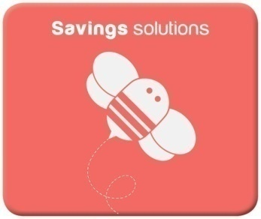
Quick Wins (2) : Increase Penetration through Cross-sell/Up-sell
Product propensity with life stage to cross-sell/up-sell insurance products and leads prioritization
Campaign Management across Channels
Cross-sell/Up-sell Strategy
Evaluation of various products for Customer X based
on Customer Value and Propensity score
Plan &
Design
Campaign Planning
Campaign Design
Campaign Strategy
Campaign P&L
Campaign Design
Prioritize
Optimize & Prioritize
Governance policy
Campaign Execution
Customer X
Execute
QA Processes
Execution
Campaign Fulfillment
Product Propensity Score for customer x
Analyze
Campaign Tracking
Analysis
Campaign Analysis
Customer Value for customer x

Slide 14
Quick Wins (3):Sales Management Framework
Maximize profitability and increase operational efficiency by optimizing sales force deployment across regions
Concept and Approach
CUSTOMERS
Dynamic Modeling
Analyze product penetration
DSA Concentration/Productivity Trend
1
2
3
4
Identify areas of
opportunity
Analyze market opportunity
relative to product penetration per district/city
Leads optimization
at DSA level &
Sales optimization
Sales Funnel
&
Simulation
Sales and Resource
Optimization
Conversion Analysis
Opportunity Grid
Product Penetration
Quick Win
Foundation
Predictive Models
Reports
Dashboards
Campaigns

Slide 15
Analytics Proposed Solution:
Proposed Roadmap

Slide 16

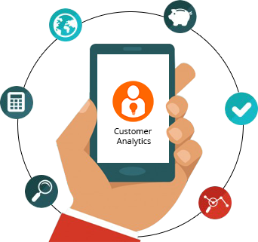
Customer Analytics Roadmap
Analytics Opportunities at various stages of customer lifecycle
Retention
- Cross-sell Propensity models
- Effective contact strategy
- Customer channel preference
- Personalized offers/promotions
- Effective product bundling
- Customer Profiling &
segmentation
- Customer risk assessment
- Life-stage based promotions
- Upsell propensity models
- Risk profiling for Fraud
- Exhaustive customer
experience and sentiment
analysis
- Share of wallet estimation
- Customer Life-time value
- Customer profitability
analysis
- Proactive/Reactive
retention strategy
- Attrition/Renewal
analysis and churn
model
- Preferential pricing for
top up policies
- Quality of acquired
customer
- Prospect Database
- Acquisition channel
- Promotional Offers
- Dynamic Pricing for
competitive advantage
Campaign
Management
Grow & Usage
Test and Learn
Cross - Sell
PL & Profitability
Acquisition

Slide 17

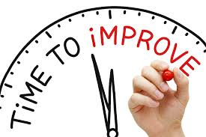
Sales & Distribution Management Roadmap
Opportunities to improve efficiency through Sales & Distribution management and forecasting
Sales Forecasting
- City level opportunity sizing
- Competitor and Market share
analysis
- Identifying drivers affecting Sales
- Time bound Sales forecasting and
monitoring
- Intervention Areas
- Sales conversion analysis
- Sales campaign analysis
- Forecast channel
performance
- Forecast new business
through customer
- Detect agency fraud and
ghost broking
- Forecast hit-to-miss ratio
- Predict the weakness and
strength and growth
potential if individual
agents & brokers
- Identify sales force productivity drivers
- Monitor performance against targets
- Sales productivity analysis
- Agent & Salesforce deployment activities
Sales & Distribution Framework
Sales Growth
Sales Force
Management

Slide 18

Claim Management Roadmap
Opportunities to improve efficiency through sales management and forecasting
- Litigation Management
- Dispute resolution
- Compliance
- Contracting
- Resource management
- Fraud prediction Models
- Fraud pattern Analysis
- Gap Analysis between
desired and Actual
controls
- Red Flag for Fraud
monitoring
- Fraud awareness Training
- Shortened Claim
Lifecycle
- Reduce Leakage
from Redundant
steps
- Automation of Claim
handling
- Real time data
- Expense
management
- Claim Initiation
- Claim Evaluation & Reporting
- Claim Tracking
- Claim fraud Investigation
Operational
Efficiency
Optimal Claim Management
Fraud
Management
Vendor
Management
Claim
Handling

Slide 19
Digital Analytics
Aligning the analytics to achieve the digital vision by harnessing the power of Social Media and Big data across the Financial Services industry
Analytical
Evolution
Analytical Complexity
Optimization
Business Analysis
Statistical Models
Customer
Life stage
Value
MIS/ Dashboard
Business Intelligence
Explanatory Analytics
Predictive Analytics
Awareness
Consistent offer & message
Generating “Word Clouds” - Positive & negative sentiments
Social Media Sentiment Analysis
Consideration
Promote and Persuade
Display Campaign, Branding
Attribution, Brand Bidding
Online Persona Segmentation
Conversion
Personalize and Convert
Fall Out Report, MVT tracking, Full Funnel Report
Channel KPI, SEO, Pathing, HP & Form Optimization, Heat Map
MVT, Contextual offering, Prospect Segmentation
Engagement
Increase satisfaction
Engagement Index, Fall out Report, Campaign Report
Opportunity Sizing,, Micro Targeting, Pathing
Digital usage propensity, Attrition Prediction
Cross-sell
Grow relationship value
Lead Generation
Triggers, Heat Map, Web Page Redesign, Market Basket
Contextual Offering

Slide 20
Building the Tata Data Ecosystem

Slide 21







Prospecting using One Tata
To drive unified data views both inside and across clusters within the Tata group
Internal Data Store
Business
Analysis
Campaign
Predictive
Analytics
Quantitative
Sciences
T1
T2
T3
T4
External Data Store
Census
CAD Ecosystem – Single Data Source
Lack of robust data infrastructure
Near Term Focus (6 months)
Lack of single golden source
Retail
Finance Cluster
Hospitality
Utilities
Tata B2C
T1
T2
T3
T4
Tata B2B
One Tata View
Challenges of Current State
Benefits of Desired State
Redundant costs – Data store, infrastructure, network
No Common platform to generate insights across clusters
Opportunity Costs – Lost sales , ineffective campaigns
Economies of scale – Drive to common data infrastructure
Centralised Data Management
Collective Insight Generation

Slide 22
Operating Model, Next Steps and Support Needed

Slide 23
Tata AIA life and Consumer Analytics Division symbiosis
Business insights is a intersection of domain knowledge, analytical solutions that harness data through analytical tools and infrastructure
Tata AIA Life
Tata
Consumer Analytics
Operating Model
Tata AIA Life
Tata Consumer Analytics
  Insurance Domain and Regulatory environment know-how
  Data and Systems know-how
  Overall governance and prioritization to steer analytics agenda
  Information Management and Analytics Expertise
  Deployable Industrial strength solutions
  Quality execution, consistent delivery, and efficiency benefits
Quick and Superior Decision Making
Effective customer management
Reduced operational expenses

Slide 24
Consumer Analytics Division: Key Offerings
Services | Description
Analytics Consulting & Development | Information Management (Data Management, Reporting/MIS, and Campaign Management) |  | Predictive Analytics
Analytics On-going Maintenance | Data Management, Reporting, Campaigns, and Predictive Models
Analytics Platform | Infrastructure (Server, Space), & Analytic Tools/Software (Analysis, Visualization, Campaign Management, Modeling)
OTHER Value-adds* | Data Attributes | Loyalty Analytics |  | Workshops
1
2
3
4
* Commercials TBD

Slide 25
Next Steps (0 to 6 months)
Immediate roles and responsibilities for the Tata Consumer Analytics Division
Steps | Plan | Detailed Plan | Responsibility
1 | Presentation to MD/CEO | Present the analytics solutions and roadmap | TCAD
2 | MOU | Detail the metadata requirements to understand current data maturity | AIA
 |  | Draft the MOU | AIA & TCAD
 |  | Sign the MOU for metadata sharing | AIA & TCAD
3 | Metadata | Share Metadata with TCAD | AIA
 |  | Evaluation of Metadata to define Proposal for Phase I | TCAD
4 | Proposal and Engagement Model | Draft of the proposal for Phase I | TCAD
 |  | Finalize the Activities, Resources and Costing | AIA & TCAD
 |  | Finalize the Proposal and Engagement model | AIA & TCAD
5 | NDA | Draft the NDA with purpose of intent, data sharing &privacy details | AIA & TCAD
 |  | Sign the NDA | AIA & TCAD
6 | Phase I – Revenue Drivers | 3 Key initiatives from Quick wins | AIA
 |  | *Monthly Review and Feedback | AIA & TCAD
 |  | *Monthly Review and Feedback | AIA & TCAD
 |  | Present the results of Phase I | AIA
* Monthly & Quarterly reviews

Slide 26
Support needed
Collaborations with the Marketing, Revenue, Legal and IT teams for a smooth engagement
1
Tata AIA Life Data Champion and Custodian
2
Strategic Business Partner to champion analytics initiatives
3
Regular Business Reviews for strategic direction & alignment

Slide 27
Appendix

Slide 28
Key Offerings
Analytic offerings across 4 focus areas for the Insurance Industry
Distribution Analytics
Marketing& Sales
Claim Analytics
Areas | Offerings
Customer Management | Profiling and segmentation Loyalty Management Customer experience, service and sentiment analysis End to end customer management from acquisition to proactive/reactive retention Customer Life-Time Value/profitability Price elasticity Customer contacts and channel preference
Sales, Channel and Distribution Management | Leads prioritization/optimization to drive qualitative sales volumes Sales effectiveness and workforce management Effective marketing communications
Claim Management | Fraud and Medical Management Risk management and monitoring Claim application and registration Underwriting and actuarial analysis
Risk Management | Vendor/Dealer Management Contracting Resource Management Expense Management
Customer
Marketing & Sales
Claim Management
Distribution
Management
Data Sources | First party website data, Mobile app data, Payment gateway data, DMP, Claims data, Social media, Distribution data, campaign data, call centre & complaints data
Predictive Analysis | Churn analysis, Sentiment Analysis, Recommendations, Attributes modeling, Social Network Analysis, Risk modeling

Slide 29
Leads for New customers: Prospect Database
Harness external, internal and group level data for quality prospecting and lead generation
Tata Internal Data (Croma, Power, AIA etc)
Tata External Data (Facebook, Twitter ,D&B etc.)
Segment level info from Tata Motors
Power consumption data from Tata Power for Risk Assessment
Aggregate bureau data
Data Integration, Customer Profiling, Segmentation etc.
Opportunity analysis
Desired
Profiles
Internal segments
Cross-sell
Campaigns &Learning
Internal (Tata AIA) data
Targets

Slide 30
Consumer Analytics Technology Stack
We have put a robust analytical capability roadmap that will cost any company ~ 2 Cr at-least
Areas | Tool set purpose | Phase 1 (Q2) | Phase 2 ( Q3 )
Data Management | Data Quality , Data ingestion, Database | Unix File system | SQL Server , Hadoop
Analytical Toolset | Statistical techniques | R Studio, WPS | Machine Learning (Python)
Visualization | MIS Reporting, Advanced Visualization | Tableau | D3 , Qlikview / SSIR
Campaign Management | Marketing Campaign , Event Based Marketing | Scripting based | Adobe / Exact-target
Infrastructure | Hosting & Servers | SFTP, Unix , Windows Server, Web server | Big Data Hadoop Grid

Slide 31
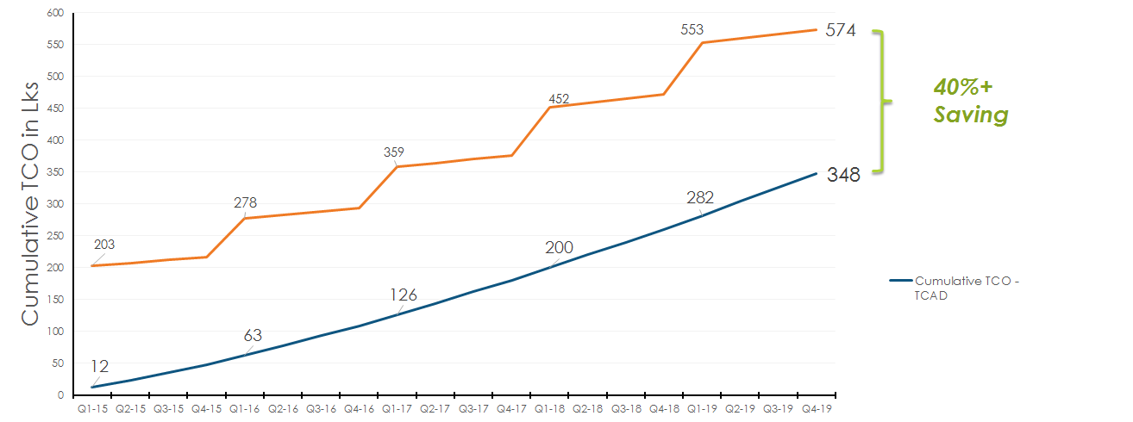
Why use Analytics on Cloud?
Diverse Toolset : Traditional tool set is costly and small scale results in high cost per analyst. Open source helps reduce TCO, needs expertise.
Shared Capacity : Better capacity utilization. Small installations, results in 30-40% unused capacity.
Scalability : Data is increasing rapidly and needs a scalable infrastructure.
Enables Data Sharing* : Enables easy data sharing across Tata groups and Power of one.
Reduced Capital Risk: Reduces risk of high capital investment and generate value with analytics investment and helps gradual scale-up.
Time to market : Faster time to market with ready platform and specialized talent and mature solution . Ready in 4-6 weeks.
Renting a analytical solution generates 40% + saving.
Assumptions : Data growth of 20% annually, and analytical infra scaling from 0.5 TB in Year 1 to Year 5.
* Contingent upon regulatory approvals and customer privacy consent for permissible data sharing across Tata Companies

